Slide 1
Database Index for Spatial, Hierarchical and Unstructured Data
Chih-Jye Wang

Slide 2
Acknowledgement
Dr. Wei-Shinn Ku, CSSE (Major Professor)
Dr. James Cross, CSSE
Dr. Alvin Lim, CSSE
Dr. Xiao Qin, CSSE
Dr. Edward Thomas, Physics (Outside Reader)

Slide 3
Abstract
Computer databases are ubiquitous and play an important role in most software projects. Although database systems has been used for more than five decades, there are still challenges to be solved. This study is composed of three parts. The first part studies hierarchical data in relational database and proposes an index to facilitate query evaluation. The second part details an index and algorithm for evaluating skyline operation in database. Final and the third part explorers the advantages and disadvantages of moving from relational database to semantic web data model using RDF.

Slide 4
Agenda
Multi-dimensional Skyline Computation via R-Tree Spatial Index
Introduction to Skyline [Review]
Skyline Computation [Review]
Experimental Results [New]
Nested Sets Hierarchical Index in Relational Database
Motivation
Adjacency List Model
Nested Sets Model
Experimental Results
Geo-Store: A Spatially-Aware SPARQL Evaluation Engine
Motivation
Just Enough RDF and SPARQL
Graph example (from course presentation)
SPARQL example
Our approach
Architecture
Filters
Live System Demo
Experimental Results
Other Work (Appendix)
MDPX
Participatory Sensor Privacy
INTACT ?

Slide 5
Spatial Index Pruning Skyline Computation

Slide 6
Introduction and Motivation

Slide 7
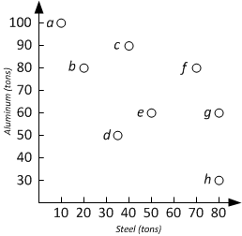

Skyline Operation
Skyline computation has broad applications
Finding the most efficient points of a data set in database
In Economics, Production Possibility Frontier (PPF) is a Skyline problem
An instance is defined as (T, σ)
T: the data set (a set of tuples)
σ: an set of minimizing/maximizing specifiers (min, max, ..)
Example: We have a set of foundries that produce both steel and aluminum, and amount produced per month.
We want to maximize both steel and aluminum. How to find the most efficient factories?
Producer | Steel | Alu
a | 10 | 100
b | 20 | 80
c | 40 | 90
d | 30.5 | 50
e | 50 | 60
f | 70 | 80
g | 80 | 60
h | 80 | 30
Production Posibility Frontier (PPF)

Slide 8
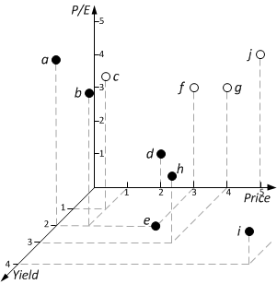
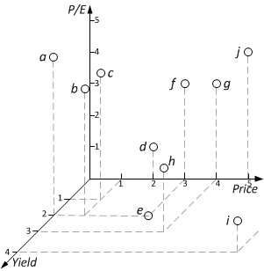
Multi-Dimensional Skyline
Stock data
Minimize
Maximize
Symbol | Price | P/E | Yield
a | 0 | 5 | 2
b | 1 | 4 | 2
c | 1 | 4 | 1
d | 2 | 2 | 0
e | 3 | 0 | 2
f | 3 | 3 | 0
g | 4 | 3 | 0
h | 4 | 2 | 3
i | 7 | 1 | 4
j | 5 | 4 | 0

Slide 9
Motivation and Research Goal
The current techniques have disadvantages:
Do not consider combinations minimizing or maximizing of attributes
Do no address skyline computation for data of arbitrary dimensions
Research Goal
Data index: support efficient and flexible skyline computation
Flexibility: algorithm allows arbitrary min and max preferences over attributes
Data Width: support data of high dimension(number of attributes)

Slide 10
Related Works

Slide 11
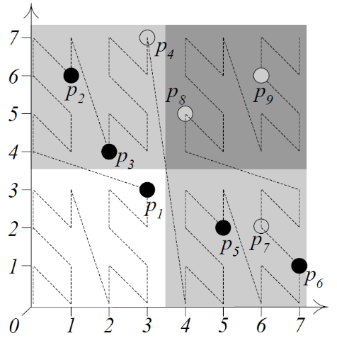
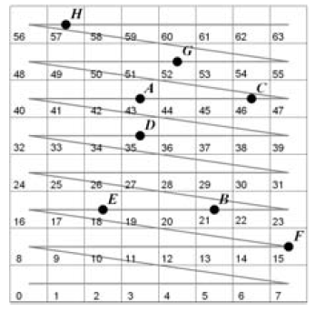
Z and Sweep Space Filling Curve
Z-Order SFC ^{[6]}
Sweep SFC ^{[7]}
Procedure
Hash data points to an integer value based on the property (order) of the SFC
Index the hash values in another data structure (such as a B-Tree) to facilitate Skyline Computation
Drawbacks
Impractical for combinations minimizing and maximizing of attributes
Computation/re-computation of Z-Curve sequence could be time consuming

Slide 12
Nearest Neighbor^{[8]}
Procedure:
Find the nearest record from the origin
Makes and insert one pruning region
Insert d additional search spaces to to-do list
Drawback
The to-do (search) list could get large for high dimension data

Slide 13

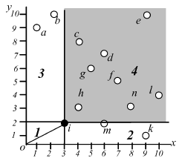
Related Works
Z-order Curve^{[6]}
Impractical for combinations minimizing and maximizing of attributes
Computation/re-computation of Z-Curve sequence could be time consuming
Nearest-Neighbor^{[8]}
Find the first skyline, and enqueue split regions
Could result in long queue, and consume large amount of memory
BBS^{[8]}
Based on spatial index (R-Tree)
Currently the best approach. Our goal is to improve memory usage and performance over BBS

Slide 14
Index-Based Pruning Skyline

Slide 15
IPS Overview
Indexing: index data points using R-Tree
Group data points into Minimum Bounding Rectangles (MBR), defined by points (min, max)
Recursively grouping MBRs into larger MBRs
We get an index tree
Query evaluation: compute skylines
Use greedy expansion of the index
Aggressively prune the search space using pruning regions

Slide 16
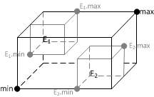
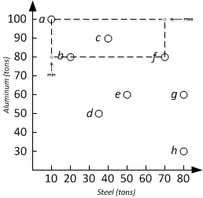
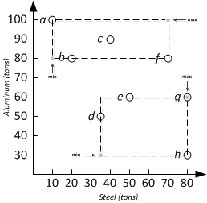
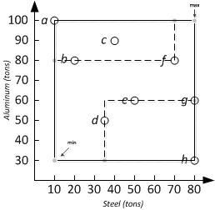
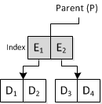
Creating R-Tree Index

Slide 17
IPS Algorithm
Use greedy expansion of the index
Find the nearest MBR using MINDIST
Insert MBRs into a Priority Queue (min heap)
Use Mindist as queue priority
Update pruning region after insert
Expand the next node on the queue
Algorithm ends when the heap is empty

Slide 18
IPS Algorithm

Slide 19
IPS Algorithm Example
b
a
c
d
Queue:
A
A2
B
A1
B
B2
Results:
a
b
c
d

Slide 20
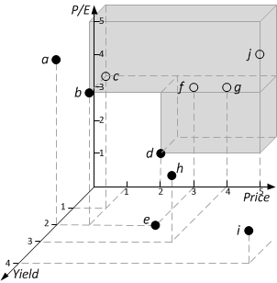
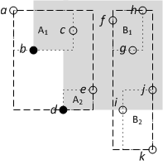
Pruning Region
A region in data space that can be pruned from searching
Regions that cannot contain skyline points, since it’s dominated by one or more data items
Minimize all attributes
Minimize: P/E, Price
Maximize: Yield

Slide 21
Experimental Evaluation

Slide 22
Evaluation Data
Synthetic generated data points
Data point distribution
Uniformed: data uniformly distributed in the search space
Rising: the attributes are correlated to the first attribute
Falling: the attribute are inversely correlated to the first attribute
Date Size
Record count: 20,000 to 100,000
Dimension: 2 to 10

Slide 23


Evaluation Data
Uniform; 10,000 points, 2-dimensional

Slide 24

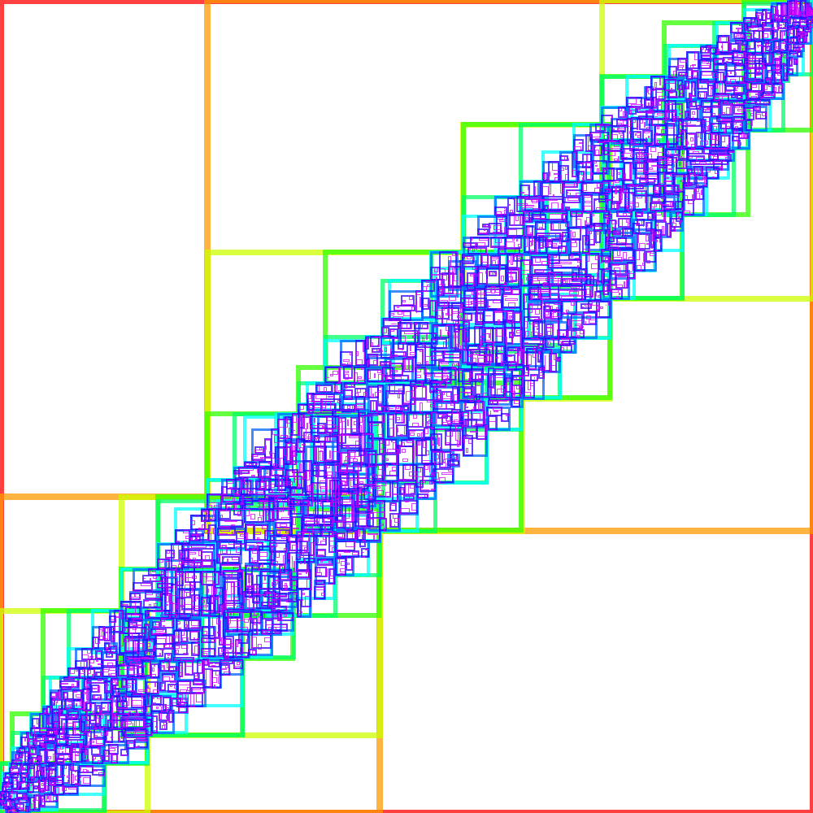
Evaluation Data
Rising; 10,000 points, 2-dimensional

Slide 25
Evaluations
Dominance Test: how many dominance comparisons performed by the algorithm
Index Percentage: amount of memory overhead of the index

Slide 26
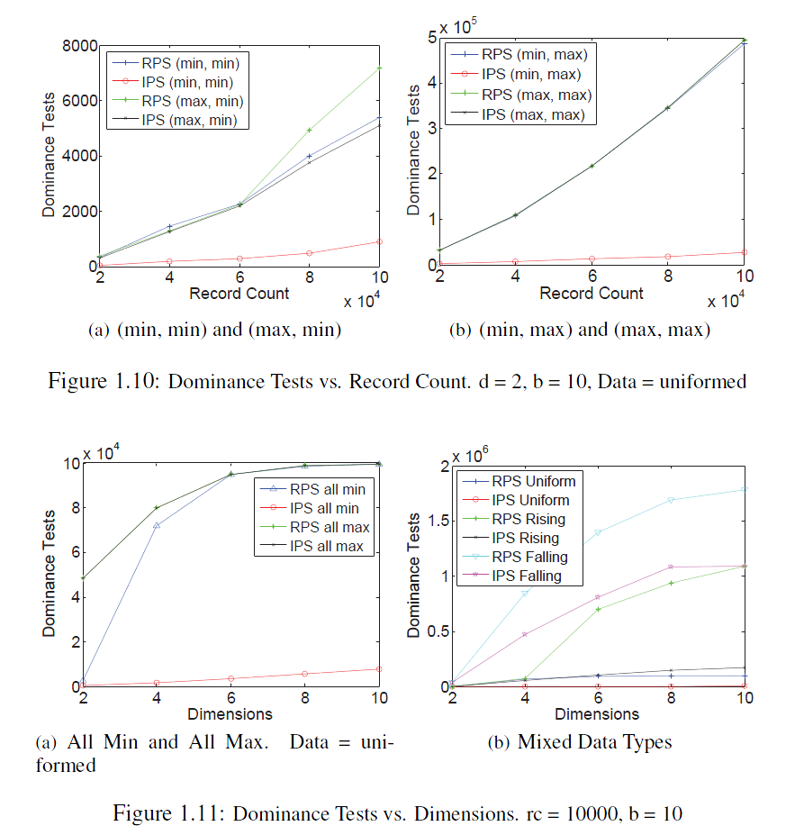
Dominance Tests

Slide 27
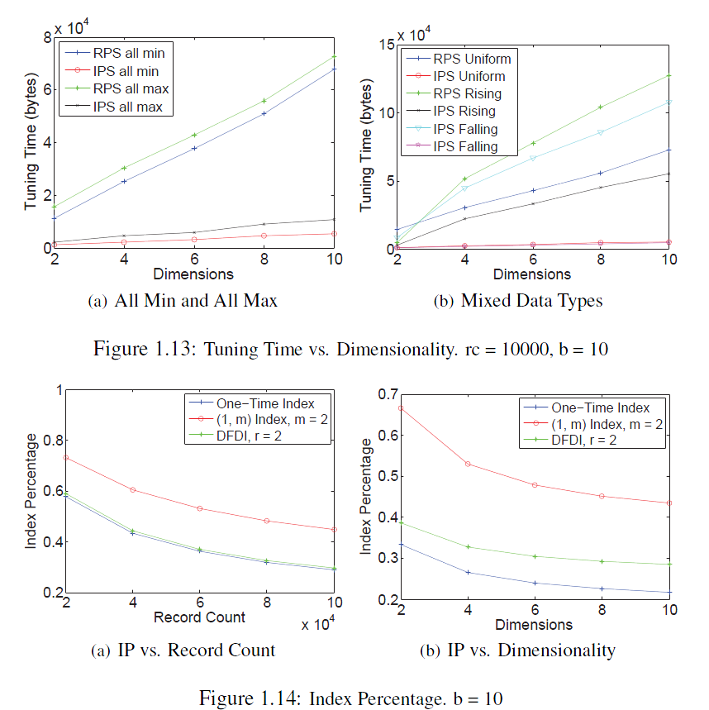
Index Overhead

Slide 28
Conclusion
Our technique IPS and early pruning has been able to provide less dominance tests and faster running time.

Slide 29
MDPX and Hierarchical Relational Database

Slide 30
MDPX
Multi-institutional Advanced plasma experiment facility at Auburn University
Built around 2013
Directed by Dr. Edward Thomas, Jr
Consists many devices that requires software control and coordination

Slide 31
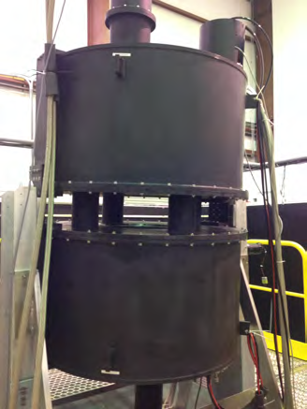
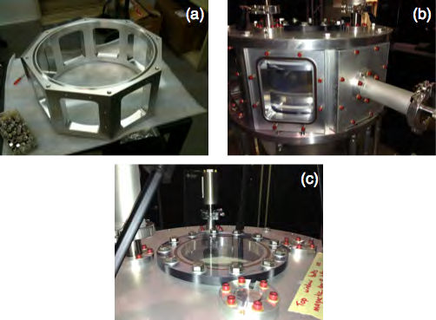
Some Pictures
Video: https://www.youtube.com/watch?v=UUudF9pZV3k

Slide 32
MDPX Control and Data Acquisition
Computer Control System
LabView control software
Communication with physical devices through National Instruments PXIe-1075 Chassis
Data is taken by LabView software and archived in various forms
Data Storage
Disk storage: raw measurements, image and video files
Searchable catalog: relational database

Slide 33
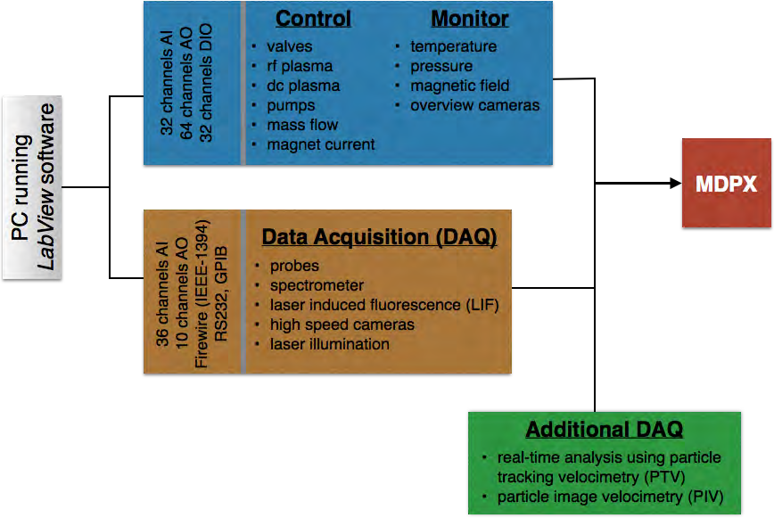
MDPX Control and Data Acquisition
Web Viewer
Relational Database
Disk Storage

Slide 34
Relational Database
Searchable experiment metadata
Experiment date, researcher, operator
Experiment configuration
Which parts are used
How are parts connected (parts hierarchy)
Summary data
Parts Catalog
Part number and serial number

Slide 35
Related Works

Slide 36
Experiments and Control Systems
Name | Start | End | Type | Institution | Location | Hardware | Software | Data Management
Alcator C-Mod | 1991 |  | Tokamak | MIT | Cambridge, Massachusetts | CPCI, PCI | Linux, IDL | MDSPlus
ASDEX Upgrade | 1991 |  | Tokamak | Max Planck Institute of Plasma Physics (IPP) | Garching, Germany
DIII-D | 1980 |  | Tokamak | General Atomics | San Diego, CA | CAMAC, Motorola 68030, LeCroy FERA | VMEexec real-time system, Unix | Disk
EAST | 2006 |  | Tokamak | Chinese Academy of Science | Anhui, China
JET | 1984 |  | Tokamak | European Union | Oxfordshire, UK | CAMAC | Solaris, C | Disk
KSTAR | 2008 |  | Tokamak | National Fusion Research Institute | Daejon, South Korea
LHD | 1998 |  | Helical Stellarator | National Institute for Fusion Science | Toki, Gifu, Japan | CPCI, NI, Yokogamwa | Windows, Linux | ODBMS
NSTX | 1999 |  | Spherical Tokamak | Princeton Plasma Physics Laboratory (PPPL) | Princeton, New Jersey | CAMAC, UNIX, Windows | Solaris, EPICS, PCS | MDSPlus
TFTR | 1982 | 1997 | Tokamak | Princeton Plasma Physics Laboratory (PPPL) | Princeton, New Jersey | CAMAC |  | Disk
TJ-I | 1983 | 1995 | Tokamak | Fusion Laboratory of Spain (CIEMAT) | Madrid, Spain
TJ-II | 1997 |  | Helical Stellarator | Fusion Laboratory of Spain (CIEMAT) | Madrid, Spain
Wendelstein 7-AS | 1988 | 2002 | Stellarator | Max Planck Institute of Plasma Physics (IPP) | Garching, Germany
Wendelstein 7-X | 2004 |  | Stellarator | Max Planck Institute of Plasma Physics (IPP) | Garching, Germany

Slide 37
MDSPlus
Characteristics
Hierarchical database designed to keep data of fusion experiments
Customizable and programmable using
Disadvantages
It’s old: does not take into account of recent database advancements
No standard query language
Data traversal, insertion, and modification has to be done using TCL commands

Slide 38
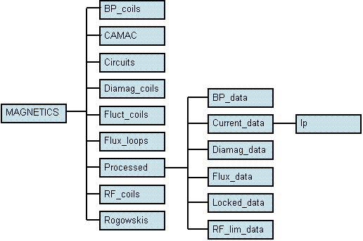
MDSPlus

Slide 39
MDSPlus
TCL> edit my_tree
TCL> add node .SUB1 #Create a new subtree. Note that the name is preceded by a dot.
TCL> set def .SUB1 #Move into SUB1 subtree. Much like the UNIX cd command.
TCL> add node SUB_NODE1/usage=numeric #Add empty node SUB_NODE1 to subtree SUB1.
TCL> add node .SUB2 # Create subtree SUB2
TCL> set def .SUB2 #Move into SUB2 subtree
TCL> add node SUB_NODE2/usage=text # Add empty node SUB_NODE2 to subtree SUB2.
TCL> write # Write the newly created tree
TCL> close # Close the tree.

Slide 40
EPICS
Distributed control system for extremely large experiments
Uses client-sever architecture
Any device (such as diagnostics) can be a server that publishes a variable
Variables can be read or set by clients that have permission

Slide 41
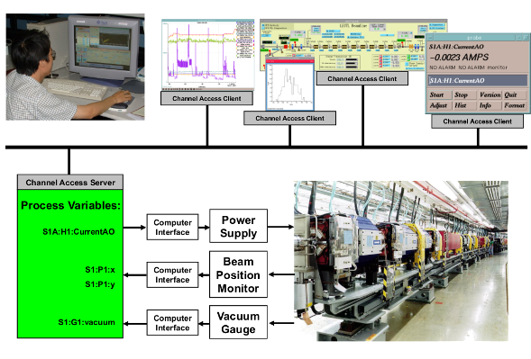
EPICS

Slide 42
Hierarchical Relational Database

Slide 43
Motivation
Hierarchical data (trees) often needed to be stored and queried in relational database^{[9]}
Example: Bill of material (or parts)
Relational database are essentially flat tables
Most techniques (of storing tree) require recursion (multiple queries) to retrieve hierarchy
Goal: Design an index technique to eliminating recursion to improve query performance

Slide 44
Operations
Given two nodes, n₁, n₂, of a tree, the following are common operations
Parent(n₁): find the parent node of n₁
Member(n₁, n₂): if n₁ is a descendent of n₂
Tree(n₁): gets the entire tree structure (all descendant nodes) of n₁
Root(n₁): gets the root node of n₁

Slide 45
Known Techniques
Adjacency List
Each data record (node) has a reference back to its parent record (parent node)
Path enumeration
Each data record maintains a complete route from the root node to the current node

Slide 46
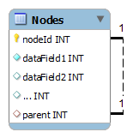
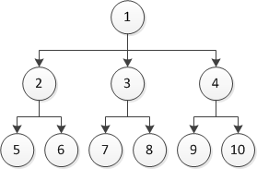
Adjacency List
Most intuitive representation
Also known as Parent-Link model
CREATE TABLE Nodes (
nodeId INT PRIMARY KEY NULL,
-- Any number of data fields
parent INT NOT NULL,
FOREIGN KEY (parent) REFERENCES Nodes(ID)
)
nodeId | parent
1 | null
2 | 1
3 | 1
4 | 1
5 | 2
6 | 2
7 | 3
8 | 3
9 | 4
10 | 4

Slide 47
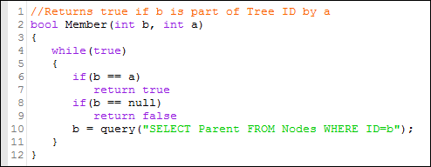
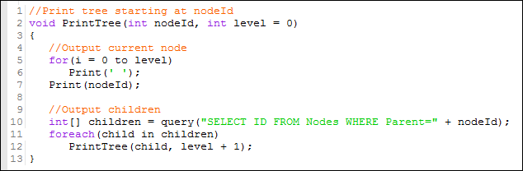
Query via Adjacency List
Member
Loop
Print Tree
Recursion

Slide 48
Path Enumeration
Path attribute denote the position of a node
nodeId | path
1 | 1
2 | 1/2
3 | 1/3
4 | 1/4
5 | 1/2/5
6 | 1/2/6
7 | 1/3/7
8 | 1/3/8
9 | 1/4/9
10 | 1/4/10
Does not need recursion, but
Require text-processing on client
Each record incurs extra transmission overhead

Slide 49
Support in Current Systems
Currently Limited and only very few systems have any support hierarchical data
Most systems do not have hierarchical syntax or functions
Support Systems
Oracle Database Systems^{[1]}
Supports nonstandard SQL syntax CONNECT BY
Still depends on recursion
Microsoft SQL Server^{[2,3]}
Supports ‘hierarchyid’ field type (since 2008)
Implement encoded path-enumeration model

Slide 50
Multi-Nested Sets

Slide 51
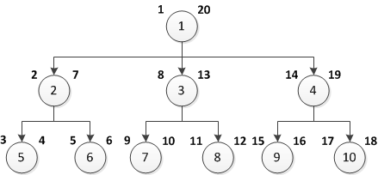
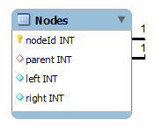
Proposed Design with Nested Set^{[5]}
An extension of adjacency list model
Two additional fields, left(L) and right(R), to denote hierarchical relationship

Slide 52
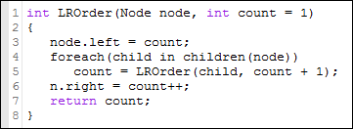
Nested Set Order Assignment
Left-Right value assignment procedure:
Steps:
Assign count to left of node n
For each child of node n, call LROrder for that child
After LROrder call is complete for each children, incement and assign count to the right value of current node

Slide 53
LR Value and Node Relationship
Given two nodes n₁, n₂ of a tree
Relationship | Conditions | SQL Query
n₁ is ancestor of n₂ | n₁.left < n₂.left and n₁.right > n₂.right | Get all ancestors of n₁: SELECT * FROM Nodes WHERE left < n1.left AND right > n1.right
n₁ is member (descendant) of n₂ | n₁.left ≥ n₂.left and n₁.right ≤ n₂.right | Get the entire tree root at n₁: SELECT * FROM Nodes WHERE (left > n1.left OR left = n1.left) AND (right < n1.right OR right = n1.right)

Slide 54
Nested Set is great but..
We can still make queries faster by designing a index for hierarchical data.
Using comparison operators in query is cumbersome and error-prone. We can design SQL extension that utilize our index.

Slide 55
Solution: Index!
LR values managed by the RDBMS (instead of the users)
Alleviate the user from having to use comparison operator
‘HIE’ attribute flag to designate a table as hierarchical
The table must have a ‘parent’ attribute
Index!: Using 2 B-Trees^{[4]}
one for left-value and one for right value
Speeds up LR-value look up
Implement hierarchical operators using the index

Slide 56
Unsolved Design Issues
Node insertion
Should we reassign all LR values?
Leave some space for new nodes?
What is the best data type for LR values?
Integers?
Real numbers?
LR value split algorithm

Slide 57
Performance Evaluation

Slide 58
Environment Configuration
Server configuration
Client Configuration
CPU | Intel Processor 64-bit
Memory | 4 GB
Operating System | Ubuntu Desktop 13.10
Database System | MySQL 5.5 Community Edition
CPU | Intel Processor 64-bit
Memory | 12 GB
Operating System | Ubuntu Desktop 13.10
Programming Language | Java 7 (OpenJDK 7)
Database Connector | JDBC mysql-connector-java-5.1.29

Slide 59
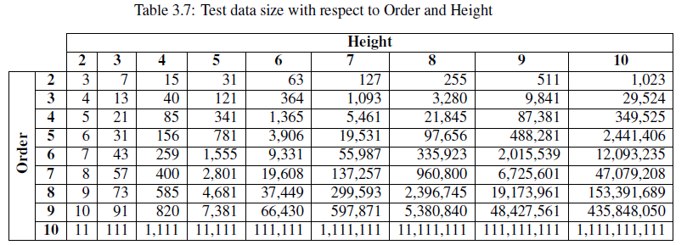
Experiment Data
Synthetically generated relational tree hierarchies
Data Properties
Order: the number of children per node
Height: the height of the longest path

Slide 60
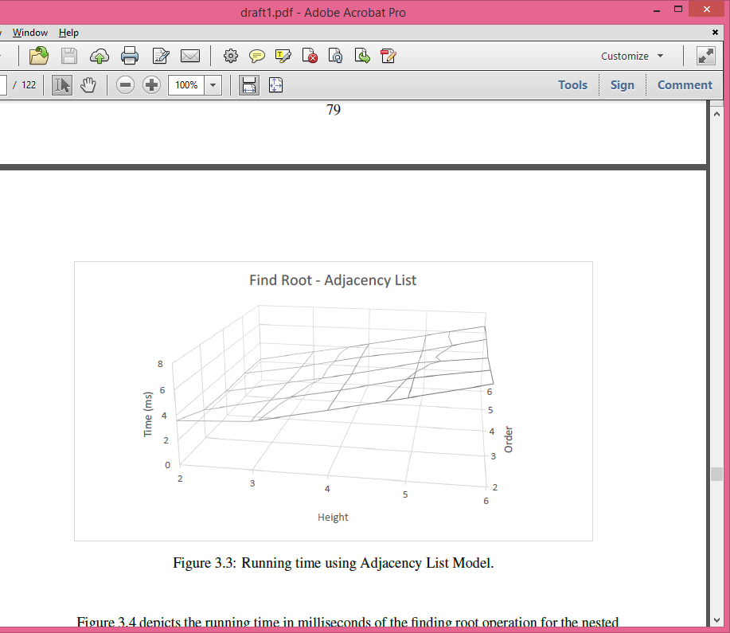
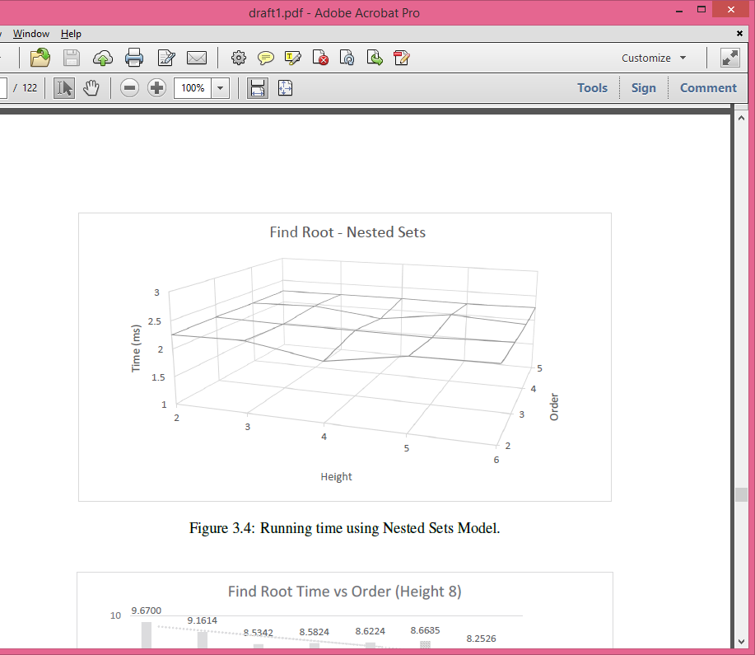
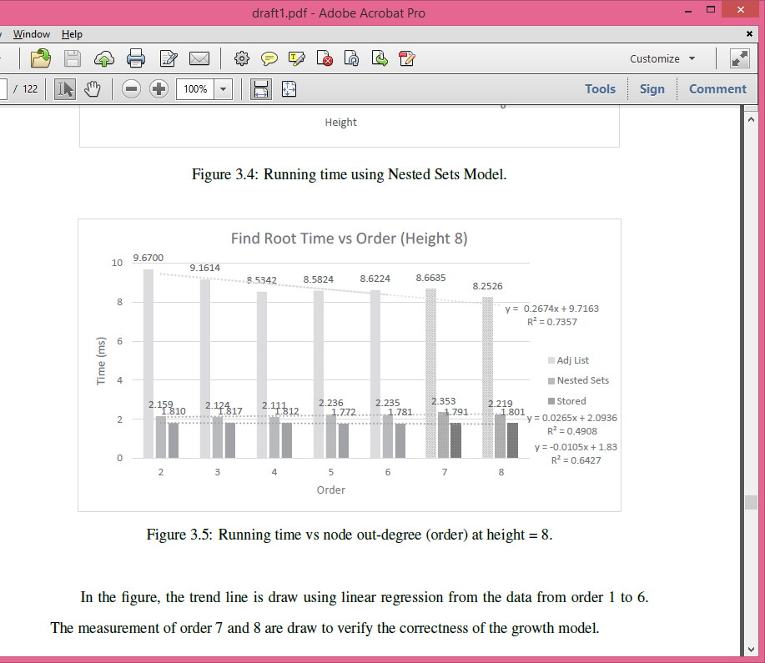
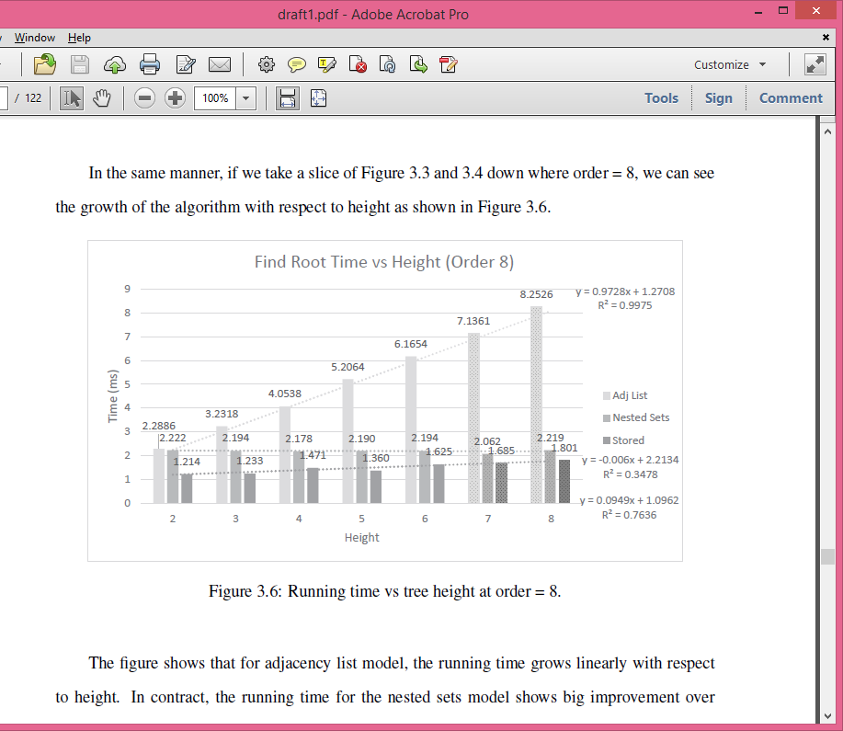
Find Root

Slide 61
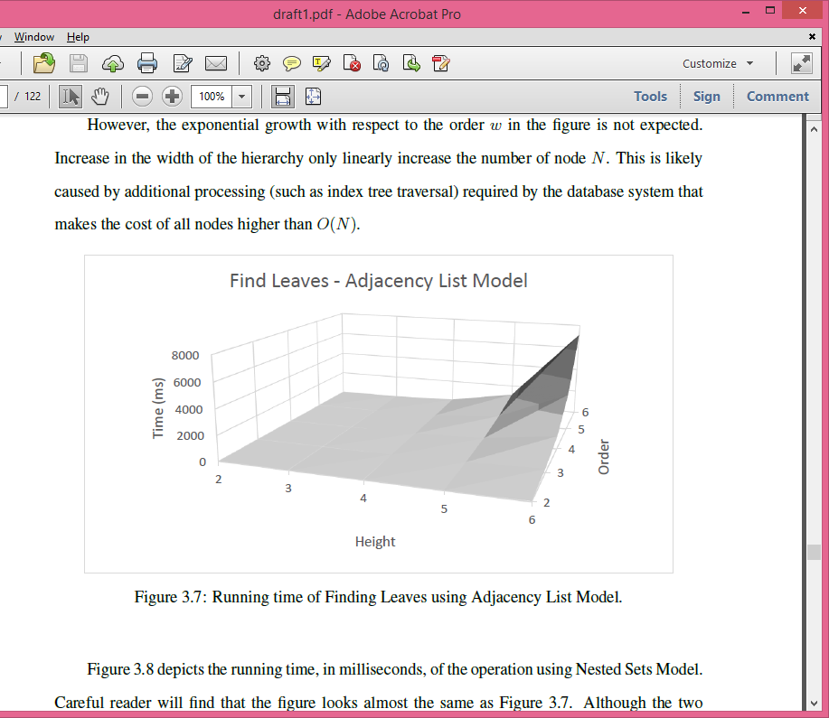
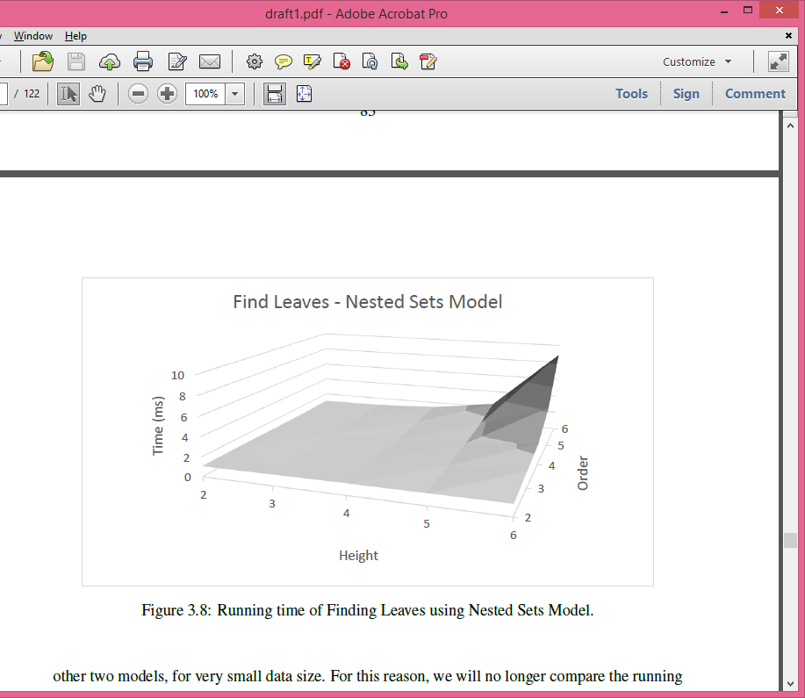
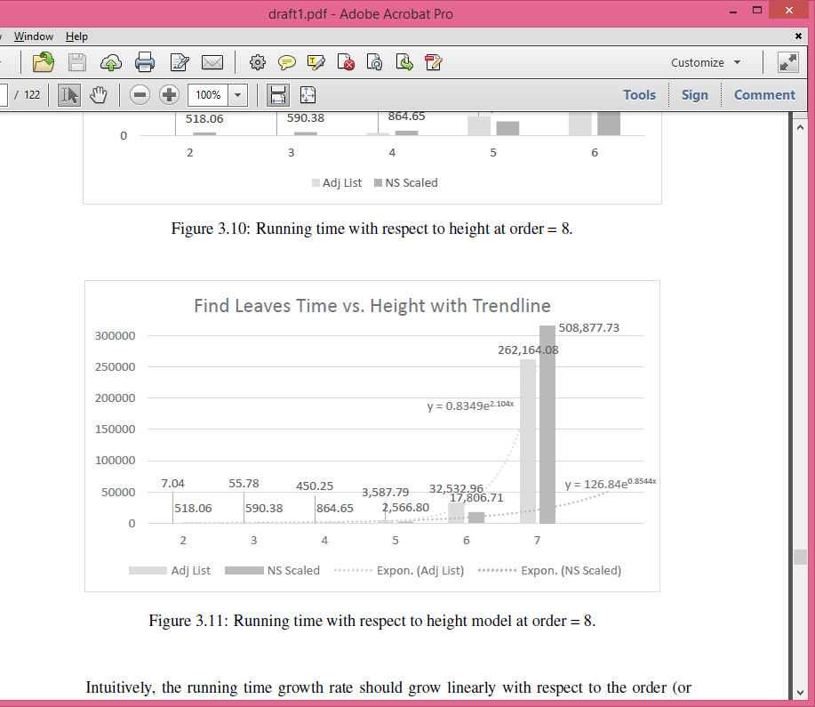
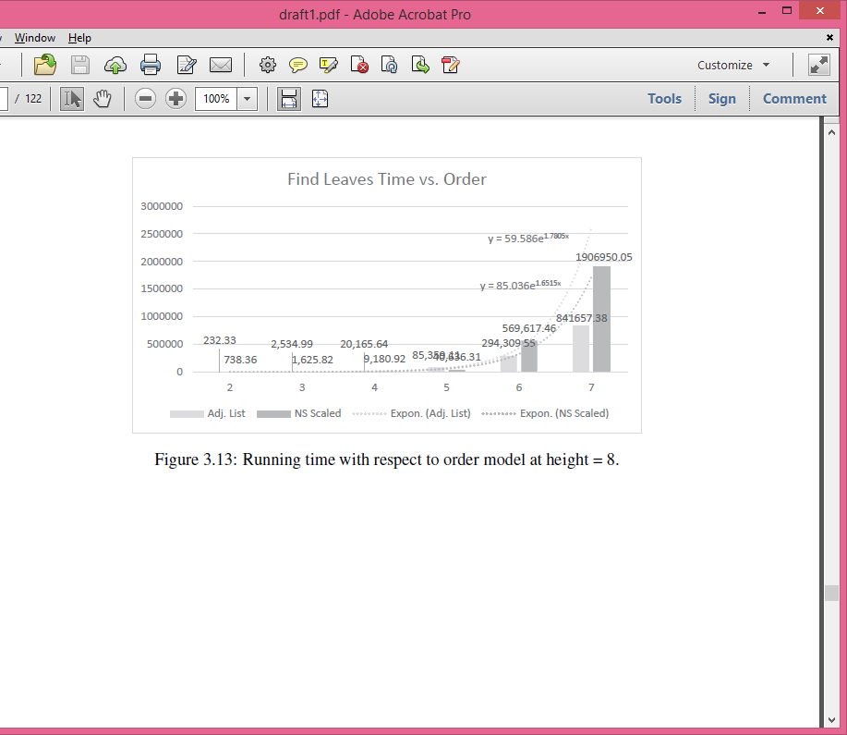
Find Leaves

Slide 62
GeoStore: A Spatially-Aware SPARQL Evaluation Engine

Slide 63
Introduction

Slide 64
Semantic Web
The dominant database system on the web is relational database and structured data
As data on the web grew, it’s harder to store data in structured way
Semantic web is a collection of standards and technologies that allow merging and utilizing data from different sources
Example: a database of celebrities

Slide 65
Resource Description Framework (RDF)
A data model for semantic web data
Describe entities (resources)
Everything is an entity: people, books
Schema-free or schema flexible
Each statement consists of
Subject (S): the entity to be described
Predicate (P): the property describing the subject
Object (O): the value for this property

Slide 66
RDF Example
<john_doe> | <name> | “John Doe”
<john_doe> | <knows> | <jane_smith>
<john_doe> | <knows> | <jack_lee>
<john_doe> | <likes> | <movie_123>
<jane_smith> | <name> | “Jane Smith”
<jane_smith> | <bday> | “1989/12/4”
<jane_smith> | <knows> | <robert_doe>
<jack_lee> | <name> | “Jack Lee”
<jack_lee> | <knows> | <robert_doe>
<jack_lee> | <sibling> | <matt_lee>
<movie123> | <title> | “The Terminator”
<movie123> | <year> | “1984”

Slide 67
SPARQL
Query language for RDF
Similar to SQL
Designed for querying graph patterns
Since RDF forms graph(s)
Bind graph pattern to ?variables
Filters on variables
Comparison
Regular expressions

Slide 68
SPARQL Examples
<john_doe> | <name> | “John Doe”
<john_doe> | <knows> | <jane_smith>
<john_doe> | <knows> | <jack_lee>
<jane_smith> | <name> | “Jane Smith”
<jane_smith> | <bday> | “1989/12/4”
<jane_smith> | <knows> | <robert_doe>
<jack_lee> | <name> | “Jack Lee”
<jack_lee> | <knows> | <robert_doe>
<jack_lee> | <sibling> | <matt_lee>
<matt_lee> | <name> | “Matt Lee”
1. Query: show the name of all entities:
2. Query: show name of all entities containing “Lee”:
3. Query: show the name of friends of “John Doe”:
select ?e ?name where {
?e <name> ?name
}
select ?e ?name where {
?e <name> ?name .
filter(?name, “Lee”)
}
select ?friend ?name where {
<john_doe> <knows> ?friend .
?friend <name> ?name
}
?e | ?name
<john_doe> | John Doe
<jack_lee> | Jack Lee
<jane_smith> | Jane Smith
?e | ?name
<jack_lee> | Jack Lee
<matt_lee> | Matt Lee
?friend | ?name
<jack_lee> | Jack Lee
<jane_smith> | Jane Smith

Slide 69
Research Goal
Implement spatial SPARQL filters
Algorithm to efficiently store point spatial data (poi)

Slide 70
Data Preprocessing

Slide 71
Data Encoding and Indexing
Encode POIs with Hilbert Space Filling Curve (SFC)
Maintain spatial locality
Augment RDF data with additional statement for the SFC encoding
Hash long strings into integer
Index all data with 7 indexes
SPO, SOP, PSO, POS, OSP, OPS
Reverse dictionary: translate integer back to string
This gives us fast SPARQL evaluation

Slide 72
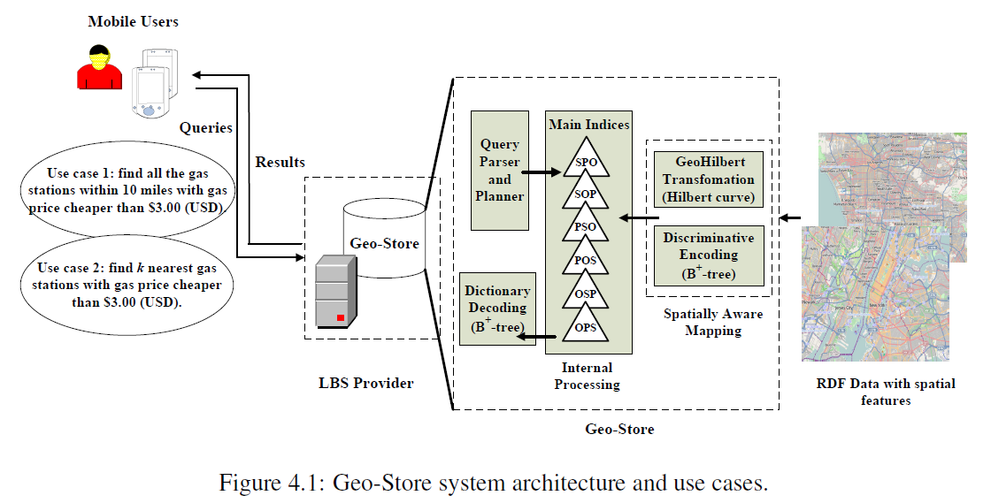
Architecture

Slide 73
Data Example
gstore:Point738330640 gml:amenity "restaurant"
gstore:Point738330640 gml:cuisine "american"
gstore:Point738330640 gml:name "Colonial Kitchen"
gstore:Point738330640 gml:pos "34.1135498 -118.1235345"
gstore:Point738330640 gstore:Pos "208083"

Slide 74
Query Evaluation

Slide 75
Spatial Filters
Range Query
Given a query point, q, and range of distance
Find all POIs that are within the range of the query point
K Nearest Neighbor Query (kNN)
Given a query point, q, and an integer, k
Find k POIs that are closest to q

Slide 76
Spatial Filters in SPARQL
Range Query
SELECT ?coordinates
WHERE {
?point a "Gas Station" .
?point gml:pos ?coordinates .
FILTER(gstore:range(?point, CURRENT_LOCATION, 10, "mile"))
?point gstore:gaspriceUSD ?price .
FILTER(?price < 3.00)
}
kNN Query
SELECT ?coordinates WHERE {
?point a "Gas Station" .
?point gml:pos ?coordinates .
FILTER(gstore:NN(?point, CURRENT_LOCATION, k))
?point gstore:gaspriceUSD ?price .
FILTER(?price < 3.00)
}

Slide 77
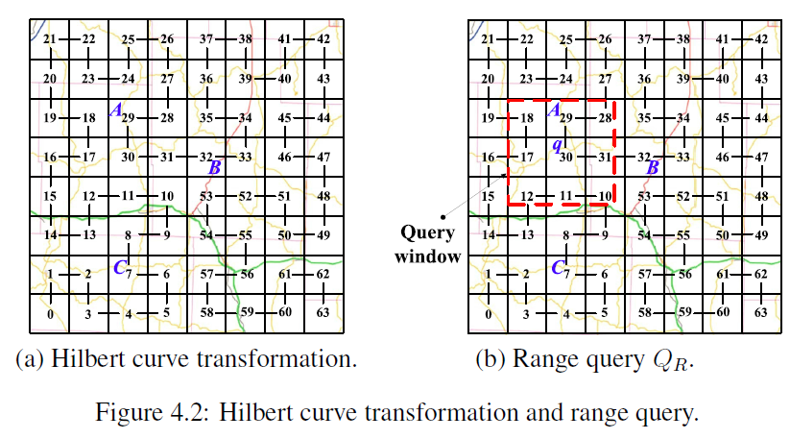
Range Filter
Find all segments of Hilbert curve values that fall into the range query
Perform search for POIs that have these Hilbert curve values
Finally, filter returned POI by calculating the distance between the query point and each POI

Slide 78
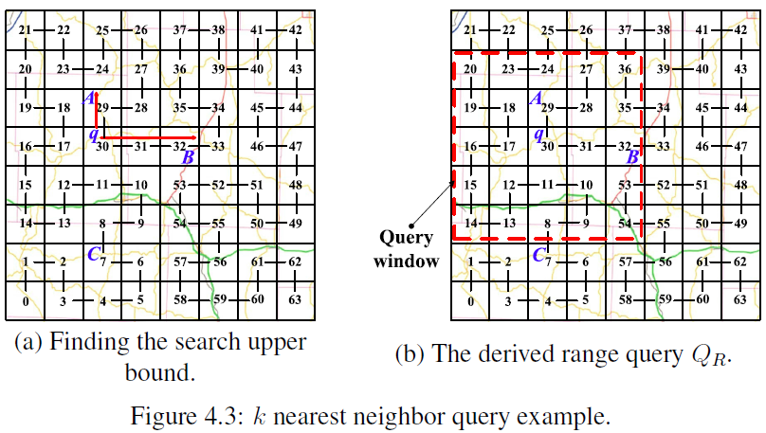
kNN Query
From query point, q, search the Hilbert curve values in both ascending and descending directions until k POIs have been found
Find the farthest object, o, from q
Perform a range query with range of distance from q to o

Slide 79
Experiment Evaluation

Slide 80
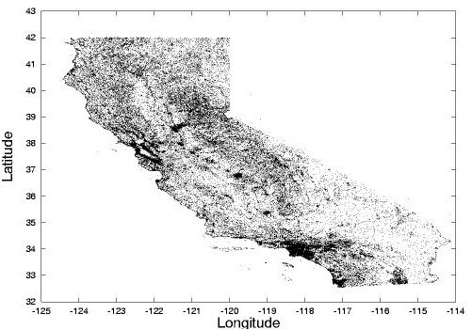
Data Set
Real data set of over 100,000 POIs in California from University of Ohio and U.S. Geological Survey¹
Each POI contains: type, latitude, longitude

Slide 81
Procedure
Range Query
Random query point
Range as percentage of area of California: 0.01% - 0.1%
Run 500 iterations and take the average
kNN Query
Random query point
K from 1 – 10
Run 500 iterations and take the average

Slide 82
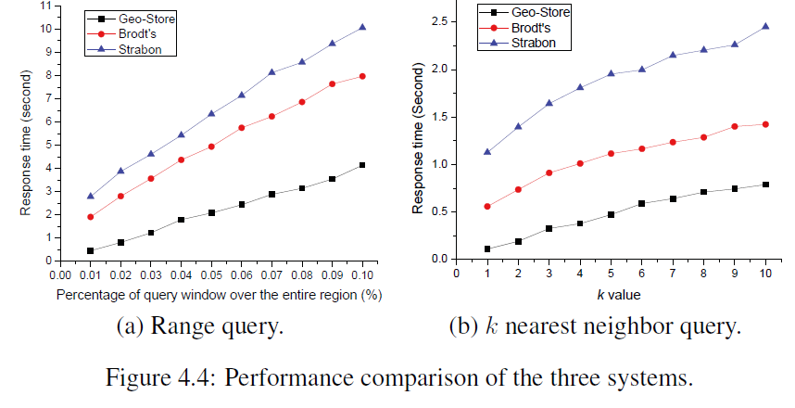
Experiment Result

Slide 83
References
Real Datasets for Spatial Databases: Road Networks and Points of Interest https://www.cs.utah.edu/~lifeifei/SpatialDataset.htm

Slide 84
References
Oracle database SQL Reference: Hierarchical Queries, http://docs.oracle.com/cd/B19306_01/server.102/b14200/queries003.htm
Hierarchical Data (SQL Server), http://msdn.microsoft.com/en-us/library/bb677173.aspx
hierarchyid (Transact-SQL), http://msdn.microsoft.com/en-us/library/bb677290.aspx
B-Tree Wikipedia: http://en.wikipedia.org/wiki/B-tree
Michael Kamfonas. Recursive hierarchies: The relational taboo! The Relational Journal.
Ken C. K. Lee, Baihua Zheng, Huajing Li, and Wang-Chien Lee. 2007. Approaching the skyline in Z order. In Proceedings of the 33rd international conference on Very large data bases (VLDB '07). VLDB Endowment 279-290. http://dl.acm.org/citation.cfm?id=1325886
JongWoo Ha, Yoon Kwon, Jae-Ho Choi, and SangKeun Lee. Energy Efficient and Progressive Strategy for Processing Skyline Queries on Air. In DEXA, pages 486–500, 2009.
Dimitris Papadias, Yufei Tao, Greg Fu, and Bernhard Seeger. Progressive skyline computation in database systems. ACM Trans. Database Syst., 30(1):41–82, 2005.
Saleslogix Developer, http://www.slxdeveloper.com/page.aspx?action=viewarticle&articleid=92
E. F. Codd. A relational model of data for large shared data banks. Commun. ACM, 13(6):377–387, 1970.

Slide 85
Published in
Chih-Jye Wang, Wei-Shinn Ku, and Haiquan Chen. 2012. Geo-Store: a spatially-augmented SPARQL query evaluation system. In Proceedings of the 20th International Conference on Advances in Geographic Information Systems (SIGSPATIAL '12). ACM, New York, NY, USA, 562-565. DOI=http://dx.doi.org/10.1145/2424321.2424416
Wei-Shinn Ku, Haiquan Chen, Chih-Jye Wang, and Chuan-Ming Liu, “Geo-Store: A Framework for Supporting Semantics Enabled Location-Based Services with RDF Triple Stores,”IEEE Internet Computing (IC), Vol. 17, No. 2, pp. 35-43, 2013.

Slide 86
Referenced by
Liagouris, John, Nikos Mamoulis, Panagiotis Bouros, and Manolis Terrovitis. "An effective encoding scheme for spatial RDF data." Proceedings of the VLDB Endowment 7, no. 12 (2014): 1271-1282. http://dl.acm.org/citation.cfm?id=2733000
Liagouris, John, Nikos Mamoulis, Panagiotis Bouros, and Manolis Terrovitis.Efficient Management of Spatial RDF Data. Technical Report TR-2014-02, CS Department, HKU, www. cs. hku. hk/research/techreps, 2014. http://www.cs.hku.hk/research/techreps/document/TR-2014-02.pdf
Patroumpas, Kostas, Giorgos Giannopoulos, and Spiros Athanasiou. "Towards GeoSpatial semantic data management: strengths, weaknesses, and challenges ahead." In Proceedings of the 22nd ACM SIGSPATIAL International Conference on Advances in Geographic Information Systems, pp. 301-310. ACM, 2014. http://dl.acm.org/citation.cfm?id=2666410

